Slide 1
Business Administration
C1

Slide 2
MARKETING AND ITS ENVIRONMENT
Marketing is the process of creating, distributing, promoting and pricing goods, services and ideas to facilitate satisfying exchange relationships in a dynamic environment.
Marketing activities help business organizations generate profits – the lifeblood of capitalist economy.
The marketing concept
The marketing concept is a management philosophy promoting a business organization to try to satisfy customer’s needs through a coordinated set of activities that also allows the organization to achieve its goals.

Slide 3
The components of a marketing strategy
Marketing strategy involves:
selecting and analyzing a target market (the group of people whom the organization wants to reach)
creating and maintaining a marketing mix (product, distribution, promotion and price) to satisfy this market.
Strategic marketing issues
Marketing strategy requires that managers focus on four tasks to achieve their objectives:
marketing opportunity analysis,
target market selection,
marketing mix development
marketing management.

Slide 4
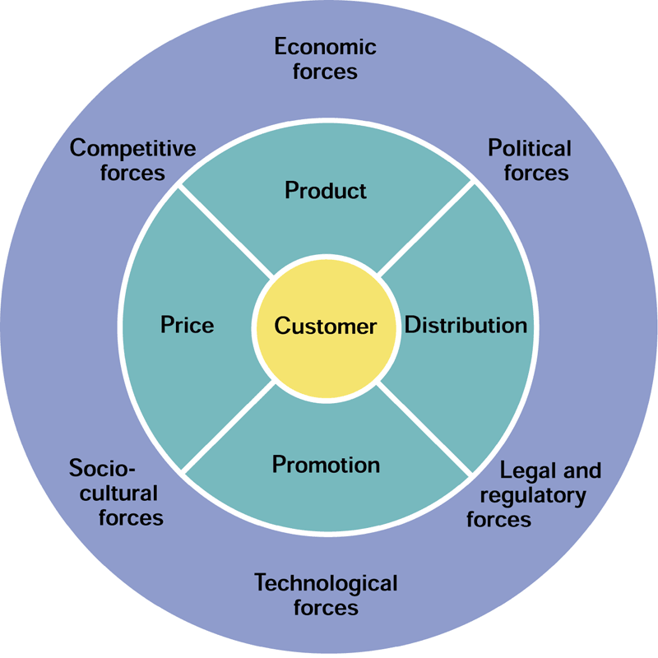
Marketing opportunity analysis involves reviewing:
internal factors (organizational objectives, financial resources, managerial skills, organizational strengths and weaknesses, cost structures),
external factors (the competitive, economic, political, legal and regulatory, technological and socio-cultural forces of the marketing environment).
A target market is a group of persons for whom a firm creates and maintains a marketing mix that specifically fits their needs and preferences.
The four marketing mix variables are product, distribution, promotion and price.
the product variable: is the aspect of the marketing mix, dealing with researching consumers’ wants and designing a product with the desired characteristics.
The distribution variable. A marketing manager tries to make products available in quantities desired to as many customers as possible and keep the total costs of inventory, transportation and storage as low as possible.

Slide 5
The promotion variable relates to activities used to inform one or more groups of people about an organization and its products.
The price variable refers to establishing pricing policies and determining product prices.
The marketing plan
A marketing plan is a written document specifying an organization’s resources, objectives, marketing strategy implementation and control efforts planned for use in marketing products.

Slide 6
Marketing Mix Variables
Product
Goods, services, or ideas that satisfy customer needs
Distribution
The ready, convenient, and timely availability of products
Promotion
Activities that inform customers about the organization and its products
Pricing
Decisions and actions that establish pricing objectives and policies and set product prices

Slide 7
The Marketing Environment
The marketing environment consists of external forces that directly or indirectly influence an organization’s:
  acquisition of inputs (personnel, financial resources, raw materials, information) and
  generation of outputs (information, packages, goods, services, ideas).
The marketing environment includes competitive, economic, political, legal and regulatory, technological and socio-cultural forces.
To monitor exchanges in these forces , marketers practice environmental scanning and analysis.
Environmental scanning is the process of collecting information about forces in the marketing environment.
Environmental analysis is the process of assessing and interpreting information obtained in scanning. This information helps marketing managers predict opportunities and threats associated with environmental fluctuations.

Slide 8
Political forces
The political, legal and regulatory forces of the marketing environment are closely interrelated.
Current political outlook is reflected in legislation and regulations or lack of them.
The legislation affecting marketing activities can be divided into :
Pro-competitive legislation - laws designed to preserve and encourage competition (e.g. the Sherman Antitrust Act sought to prevent monopolies and activities to limit competition)
Consumer protection laws.
Effects of new technology
Several factors determine how much and in what way a particular business uses technology; these factors include:
the firm’s ability to use technology,
consumers’ ability and willingness to buy technologically improved products,

Slide 9
the firm’s perception of the long-run effects of applying technology,
the extent to which the firm is technologically based,
the degree to which technology is used as a competitive tool and the extent to which the business can protect technological applications through patents.
Sociocultural issues
Socio-cultural forces are the influences in a society and its culture that result in changes in attitudes, beliefs, norms, customs, and lifestyles. Four major socio-cultural issues directly influencing marketers include:
demographic characteristics,
cultural values,
cultural diversity
the consumer movement.

Slide 10
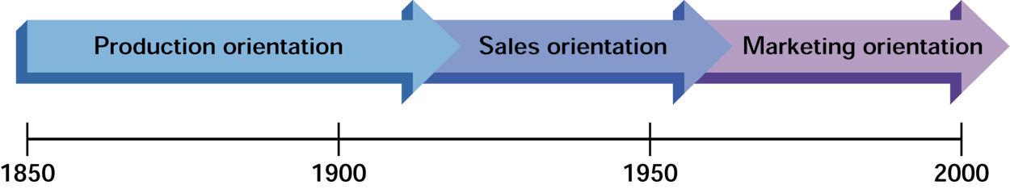
Evolution of the Marketing Concept
Product
Orientation
Late 19th century: efficient production of goods allowed firms to meet strong customer demand.
Sales
Orientation
Mid-1920s–early 1950s: weakened demand required that products would have to be “sold.” (personal selling, advertising, and distribution was the focus)
Marketing
Orientation
Early 1950s–2000s: adopting a customer focus means a commitment to researching and responding to customer needs.
FIGURE 1.3

Slide 11
Marketing Ethics and Social Responsibility
Marketing ethics are moral principles that define right and wrong behavior in marketing.
Many marketing decisions can be deemed either ethical or non-ethical but others can not be so clearly categorized. Marketers need assistance with primarily two types of ethical challenge:
decisions in “gray” areas where the “right “ decision is debatable,
decisions where the right course of action is clear, but individual and organizational pressures along with situational circumstances, push the marketer in the wrong direction.

Slide 12
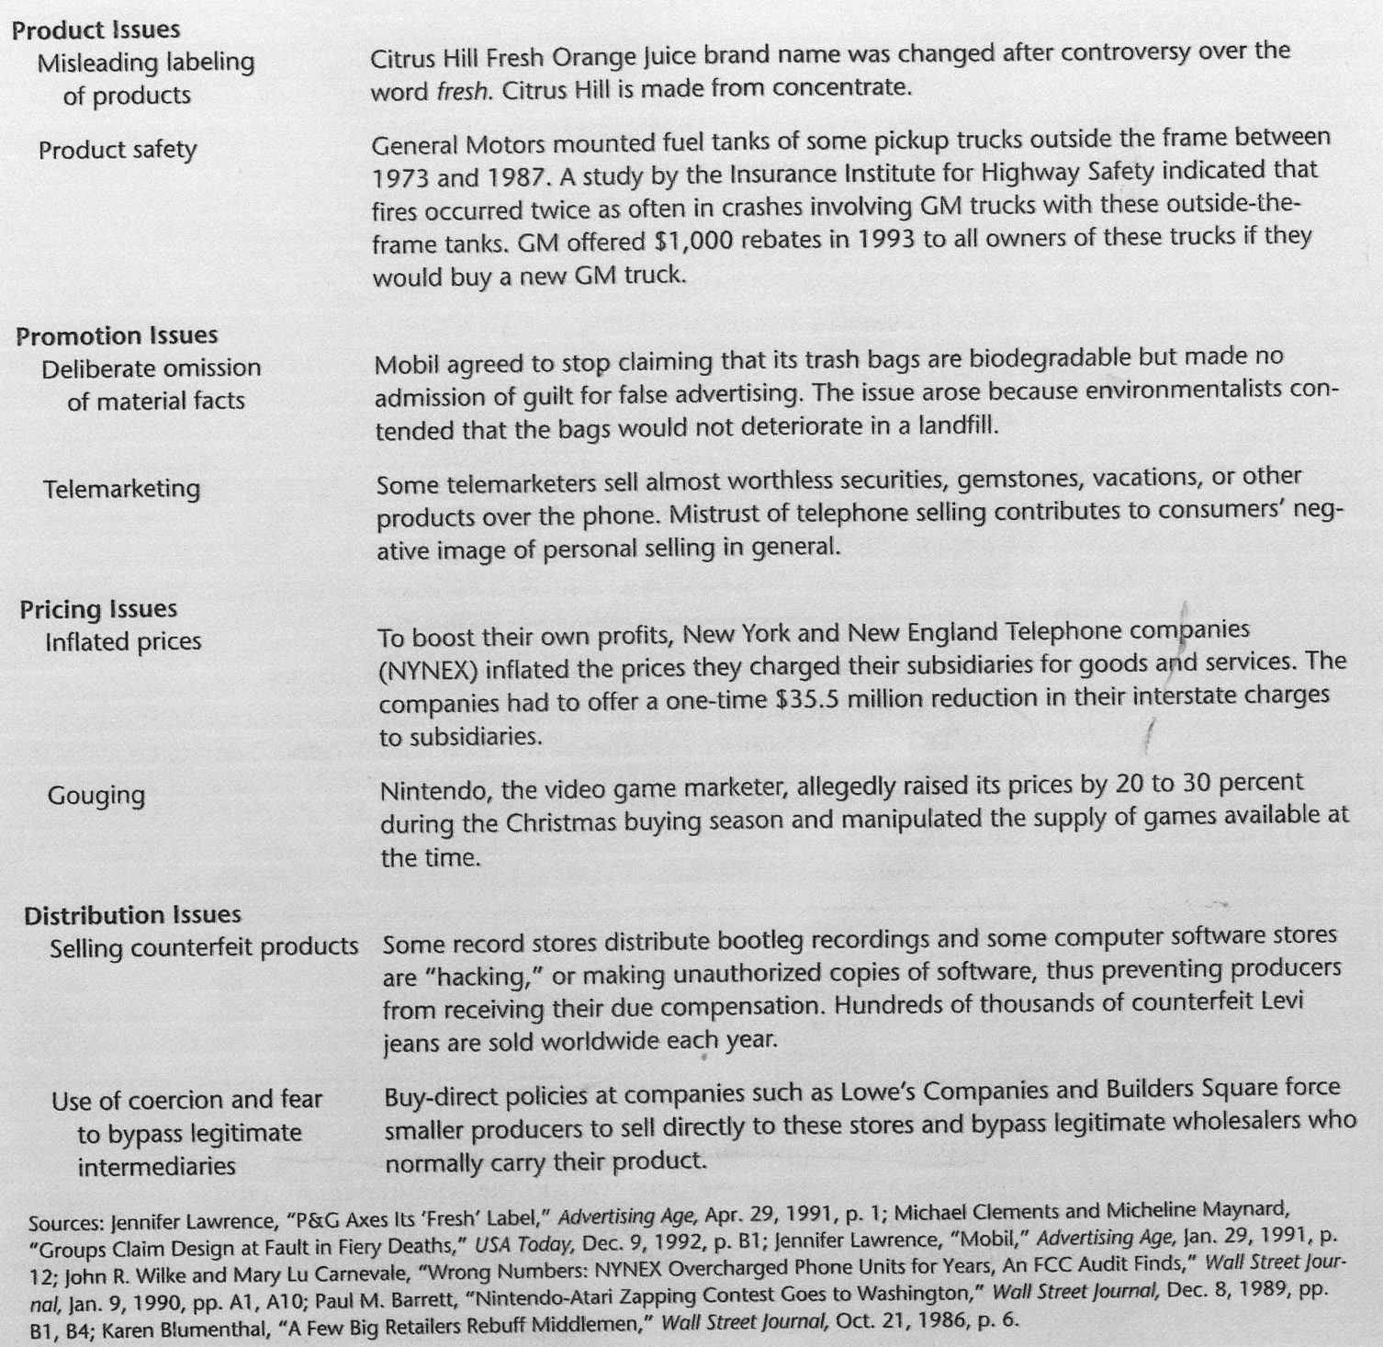

Slide 13
Improving ethical behavior
Organizations can improve the ethical behavior by formalizing what the organization expects of its employees.
Codes of ethics are formal statements of rules and standards that should guide in a given organization. Employees thus know what is expected of them and what the punishments could be for violating the rules. It is important to make ethics a part of everyday job responsibility.
If managers and coworkers can provide direction and encourage ethical decision making, then they become a force helping individuals make better ethical decisions.
Social responsibility
Social responsibility in marketing refers to an organization’s obligation to maximize its positive impact and minimize its negative impact on society.

Slide 14
The four dimensions of social responsibility are generally considered to be:
  economic,
  legal,
  ethical,
  philanthropic.
Major categories of social responsibility issues include:
  the consumer movement,
  community relations,
  green marketing and
  diversity.
The consumer movement refers to the efforts of independent individuals, groups, and organizations to protect consumer’s rights

Slide 15
Social responsibility also extends the marketers’ roles as community members. Society expects marketers to contribute to the satisfaction and growth of their communities.
Green marketing refers to the specific development, pricing, promotion, and distribution of products that do not harm the environment.
Diversity in the workplace is the integration and utilization of a work force that reflects the general population. It also means greater awareness and acceptance of cultural differences.
The concepts of marketing ethics and social responsibility are interrelated because a company that supports socially responsible decisions, as well as individuals and groups that act ethically is likely to have a positive impact on society.

Slide 16
Global Markets and International Marketing
Although most firms adjust their marketing mixes for differences in target markets, some firms are able to standardize their marketing efforts worldwide.
Traditional full-scale international marketing involvement is based on products customized according to cultural, regional and national differences.
Globalization, however, involves developing marketing strategies as if the entire world (or regions of it) were a single entity; a globalized firm markets standardized products in the same way everywhere.

Slide 17
Environmental elements that create global markets
A detailed analysis of the environment is essential before a company enters a foreign market. Environmental aspects of special importance include:
cultural,
social,
economic,
political and
legal forces.
Cultural aspects of the environment that are most important to international marketers include customs, concepts, values, attitudes, morals and knowledge.
Marketing activities are primarily social in purpose; therefore they are influenced by the institutions of family, religion, education, health and recreation.
The most proeminent economic forces that affect international marketing are those that can be measured by income and resources.

Slide 18
Political and legal forces include the political system, national laws, regulatory bodies, national pressure groups and courts.
Foreign policies of all nations that are involved in trade determine how marketing can be conducted
Involvement in international marketing activities
There are several ways of getting involved in international marketing.
Exporting is the easiest and most flexible method.
Licensing is an alternative to direct investment; it may be necessitated by political and economic conditions.
Joint ventures and strategic alliances are often appropriate when outside resources are needed, when there are governmental restrictions on foreign ownership or when changes in global markets encourage competitive consolidation.

Slide 19
Direct investment
Trading companies are experts at buying products in the domestic market and selling to foreign markets, thereby taking most of the risk in international involvement. Direct ownership of foreign divisions or subsidiaries is the strongest commitment to international marketing and involves the greatest risk.
When a company has operations or subsidiaries located in many countries, it is termed a multinational enterprise.

